Slide 1

Logical Agents
Introduction to Logical Agents
Prof. Tarachand Amgoth

Slide 2
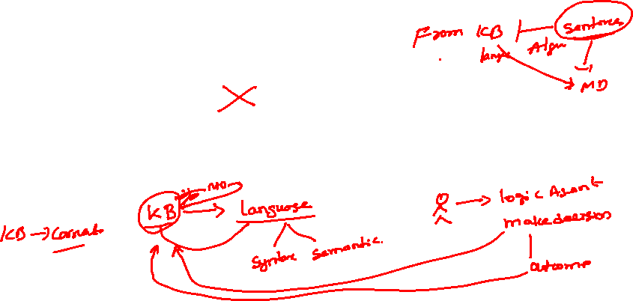
Introduction to Logical Agents
Humans, it seems, know things; and what they know helps them do things.
These are not empty statements.
They make strong claims about how the intelligence of humans is achieved—not by purely reflex mechanisms but by processes of reasoning that operate on internal representations of knowledge.
In AI, this approach to intelligence is embodied in knowledge-based agents.

Slide 3

Introduction to Logical Agents
What are Logical Agents?
  Logical agents are AI systems that use formal logic to represent and reason about knowledge.
  They can derive new information from existing knowledge and use this to make decisions.
Why Logical Agents?
  Logical reasoning provides a solid foundation for developing AI that can operate in complex environments, making decisions based on a structured understanding of the world.

Slide 4
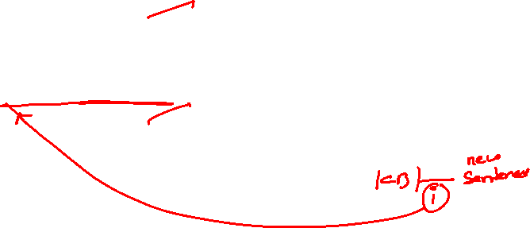
Key Components of Logical Agents
Knowledge Base (KB):
  A repository of facts and rules about the world, represented in a formal language.
Inference Mechanism:
  A set of logical rules or algorithms that the agent uses to derive new information from the KB.

Slide 5
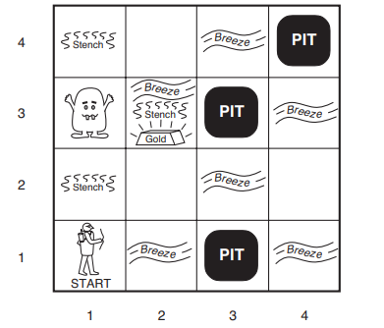
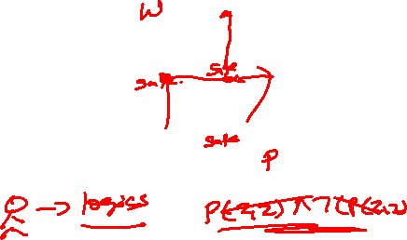
The Wumpus World Example
Overview: Wumpus World is a popular AI problem used to illustrate logical reasoning and decision-making in uncertain environments.
Purpose:
  To demonstrate how an agent can navigate a world full of hazards using logic to deduce safe actions.

Slide 6
Wumpus World: The Environment
Structure: A 4x4 grid world, where each square can contain hazards (pits or the Wumpus) or rewards (gold).
Key Components:
  Agent: Starts in the bottom-left corner (1,1).
  Wumpus: A monster that kills the agent if they move into its square.
  Pits: Deadly traps that kill the agent if they fall into them.
  Gold: The objective of the agent; must find and carry it back to the starting point.
Percepts:
  Breeze: Felt in squares adjacent to a pit.
  Stench: Smelled in squares adjacent to the Wumpus.
  Glitter: Seen in the square with the gold.

Slide 7
Wumpus World: Agent’s Objective
Goal:
Safely navigate the grid to find the gold and return to the starting point (1,1).
Challenges:
The world is partially observable; the agent only perceives local information (breeze, stench, glitter).
The agent must make decisions with incomplete information, using logical inference to deduce safe paths.

Slide 8
Agent’s Percept and Actions
Percepts:
  Breeze: Indicates a pit in an adjacent square.
  Stench: Indicates the Wumpus is in an adjacent square.
  Glitter: Indicates the presence of gold in the current square.
Actions:
  Move Forward: The agent can move to an adjacent square.
  Turn Left/Right: Changes the agent’s direction.
  Grab: Picks up the gold if the agent is in the same square.
  Shoot: Fires an arrow in the direction the agent is facing, killing the Wumpus if it is in that direction.
  Climb: Exits the cave if the agent is in the starting square.

Slide 9
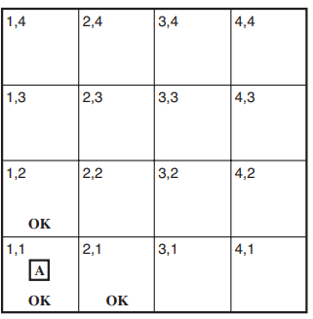
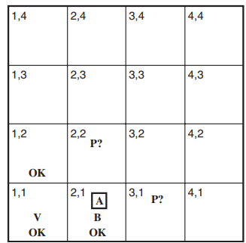
Wumpus World: Logical Reasoning
Reasoning Process:
The agent uses logical reasoning to infer the safest actions based on its percepts.
Example:
Percept: The agent feels a breeze at (2,1).
Inference: There is at least one pit in the adjacent squares (1,1), (2,2), or (3,1).
Decision: The agent avoids these squares until further information narrows down the exact location of the pit.
Knowledge Base (KB):
The agent maintains a knowledge base of known facts and uses inference rules to deduce new information.
Example: If the agent knows "There is a breeze in (2,1)" and "A breeze means there is a pit nearby," it adds this to its KB and reasons accordingly.

Slide 10
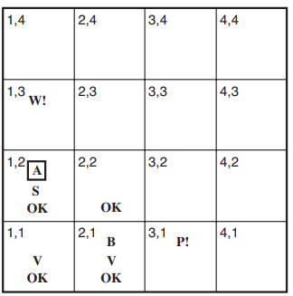
Wumpus World Example: Decision-Making Process
Scenario:
The agent is in (2,2), perceives a breeze, and has previous knowledge about adjacent squares.
Decision Process:
Step 1: The agent checks its KB for known safe squares.
Step 2: The agent infers potential pit locations based on the breeze percept.
Step 3: The agent uses this information to decide where to move next.
Action: The agent chooses a square to move to, avoiding high-risk areas.

Slide 11
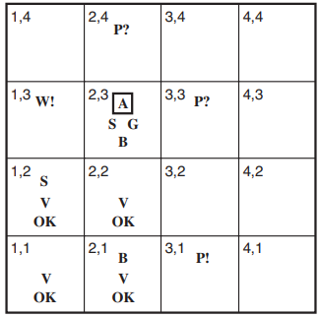
Example Walkthrough: A Complete Run
Initial State: The agent starts at (1,1), where there are no percepts (no breeze, no stench).
Move 1: The agent moves to (2,1) and perceives a breeze.
Inference: The agent deduces that there is a pit in one of the adjacent squares (1,1), (2,2), or (3,1).
Next Moves: The agent continues exploring, carefully choosing moves that minimize risk, updating its KB after each move.
End Game: The agent finds the gold at (2,3) and returns to (1,1) to exit the cave.

Slide 12
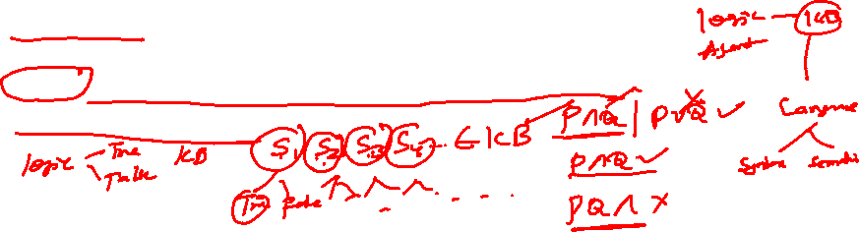
Logic: Syntax and Semantics
Syntax defines the formal structure of sentences in a logical language. It is the set of rules that determines how symbols can be combined to create valid expressions.
Semantics assigns meaning to the syntax. It interprets the logical sentences by defining truth values based on an interpretation or model.
Interpretation: An interpretation is a specific assignment of truth values to the atomic sentences.
Model: A model is an interpretation in which all sentences in the knowledge base are true.

Slide 13
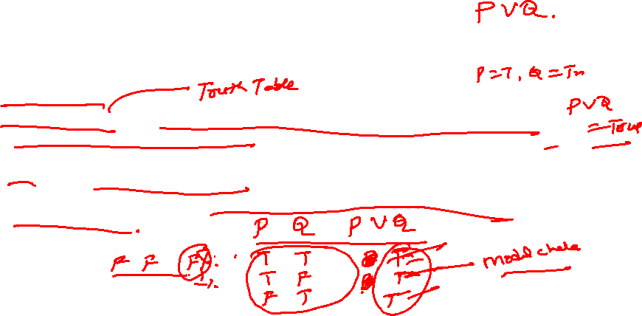
Model and Model Checking
A model is a specific interpretation where all sentences in a given set (knowledge base) are true.
Model checking is a technique used to determine whether a given sentence is true in a specific model.
Model Checking: It involves evaluating a logical formula within a given model to check if the formula holds true.
Process: The agent specifies a model (which assigns truth values to all relevant propositions) and checks whether the logical formula evaluates to true in that model.

Slide 14
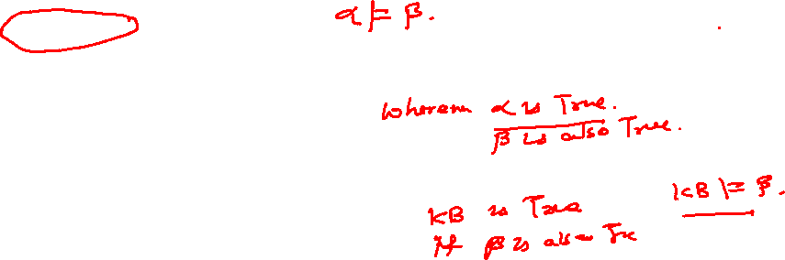
Entailment in Logic
Entailment is a core concept in logic that describes the relationship between statements where one statement logically follows from another.
Entailment:
  A sentence α entails another sentence β if in every model where α is true, β is also true.
  Denoted as α⊨β
Importance: Central concept in reasoning derives new truths from known facts.

Slide 15
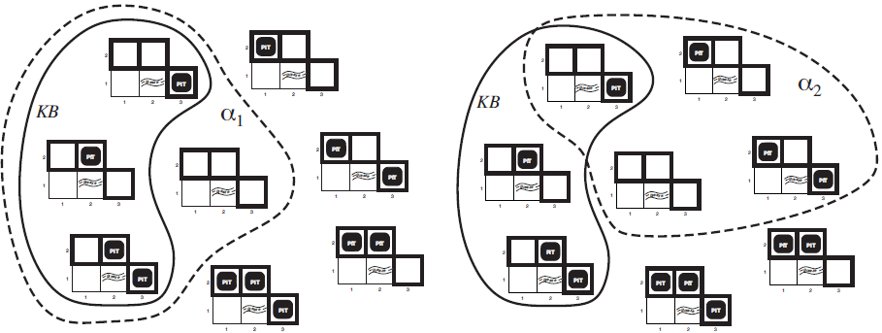

Entailment in Logic

Slide 16
Soundness and Completeness
Soundness?
  A logical system is sound if every sentence that can be derived from the knowledge base is true in the real world (i.e., if α⊢β, then α⊨β).
Importance of Soundness: Ensures that the agent only derives conclusions that are true, avoiding false positives.
Completeness?
  A logical system is complete if every sentence that is true in the real world can be derived from the knowledge base (i.e., if α⊨β, then α⊢β).
Importance of Completeness: Ensures that the agent can derive all necessary conclusions from the knowledge base, avoiding false negatives.

Slide 17
Soundness
Soundness: A reasoning system is sound if every conclusion or inference it derives is logically correct or true according to the rules of the logic.
In simpler terms, if the system concludes something, it must be a valid conclusion based on the premises.
Example:
  If a logical agent uses a set of rules to infer that "All humans are mortal" and "Socrates is a human," the conclusion "Socrates is mortal" must be true.
  If the agent infers something false from true premises, then the system is unsound.

Slide 18
Soundness
Formal Example:
  Premises:
    ∀x(Human(x)→Mortal(x)) (All humans are mortal)
    Human(Socrates) (Socrates is human)
  Conclusion:
    Mortal(Socrates) (Socrates is mortal)
  Since the conclusion logically follows from the premises, this is a sound inference.

Slide 19
Completeness
Completeness: A reasoning system is complete if it can derive every possible conclusion that is logically entailed by the premises.
In other words, if something is true based on the premises, the system should be able to infer it.
Example:
  Suppose an agent knows the premises "All humans are mortal" and "Socrates is a human."
  If the system is complete, it should eventually deduce that "Socrates is mortal."
  If the system fails to infer a valid conclusion that follows from the premises, it is incomplete.

Slide 20
Completeness
Formal Example:
Premises:
  ∀x(Human(x)→Mortal(x))
  Human(Socrates)
A complete system must derive Mortal(Socrates) from the above premises.

Slide 21
Examples of Soundness and Completeness
Propositional Logic Example
Scenario: Consider a logical agent that reasons using propositional logic with the following premises:
  P→Q (If it rains, the ground will be wet)
  P (It is raining)
Soundness: The agent infers Q (The ground is wet). This conclusion is logically sound because it correctly follows from the premises.
Completeness: The agent must be able to derive Q whenever P and P→Q are given. If it fails to derive this, the system is incomplete.

Slide 22
Examples of Soundness and Completeness
First-Order Logic Example
Scenario: Suppose an agent uses first-order logic and the following facts:
  ∀x(Student(x)→Studies(x)) (All students study)
  Student(John) (John is a student)
Soundness: The agent infers that Studies(John) (John studies). This is a sound inference because it follows the rules of logic.
Completeness: A complete system would be able to derive Studies(John) from the premises. If the system fails to infer this valid conclusion, it would be incomplete.

Slide 23
Examples of Soundness and Completeness
A Real-World Example of Logical Agents
Scenario: A medical diagnosis system uses logical rules to infer diseases based on symptoms. Suppose the rules are:
  Fever(x)→Flu(x) (If a person has a fever, they might have the flu)
  Fever(John) (John has a fever)
Soundness: The system infers that John has the flu based on the above rules. This is sound because the conclusion follows the rules.
Completeness: The system should also be able to infer other conditions related to John's symptoms. If the system only infers the flu but misses another possible disease that logically follows from the rules, it is incomplete.

Slide 24
Importance of Soundness and Completeness
Soundness ensures that the agent does not make false conclusions, maintaining the reliability of the system.
In a system without soundness, incorrect decisions could lead to undesirable outcomes, such as making wrong medical diagnoses or faulty autonomous system actions.
Completeness ensures that the agent can infer all possible conclusions from the given information, allowing it to explore all valid inferences.
Incomplete systems might fail to recognize important facts, leaving gaps in the reasoning process, such as missing out on a critical diagnosis in a healthcare system.

